Slide 1
s
Notes:
‹#›
‹#›
My journey. Example of a personal “rude” experience.

Slide 2
Consider people you respect ...
Why do you respect them?
Why are they effective?
Did they make lasting changes?
What can you learn from them?
Do they have anything on common?
s
Notes:
‹#›
‹#›
Thought more about them.

Slide 3
Do they have these characteristics?
Show respect for others?
Really listen to others?
Not personalize disagreements and opinions?
Are effective at getting things done?
s
Notes:
‹#›
‹#›
And then I thought about this civility idea. Hard to define but how it is described

Slide 4
What Civility looks like...
Show respect for others…...
Actively listen to others……..
Not personalize disagreements and opinions…
Effective at getting things done...
Anything in common with the previous list?
s
Notes:
‹#›
‹#›
Respect for others - Empathy
Really listen to others - active listening
Not personal disagreements - active dialog
Effective at getting things done - leader

Slide 5
Why we need Civility...
Model behavior for our youth…...
Need to solve problems……..
Need to interact with people of differing backgrounds…
s
Notes:
‹#›
‹#›
So why talk about it in at a Masonic meeting?

Slide 6
What Masonry can add...
MASONIC HERITAGE
CULTURAL SENSITIVITY
DELIVERY SYSTEM
Masons have a long history
of fostering civil dialogue and
building civil societies.
Our lodges and worldwide
presence provide an intriguing
system to deliver
programs and information.
Masons are diverse and our
lodges represent people of
different:
Places of origin
Language
Races
Disability
Other
s
Notes:
‹#›
‹#›
What are masons doing?

Slide 7
What are Masons doing?...
In 2014, Masonic Leaders across North America joined forces to address the need for civility in society.
This is not just a California initiative--It is worldwide
Identifying resources, tools, strategies…
Civility web site
Civility Toolkit online
Exploring strategies for next steps
s
Notes:
‹#›
‹#›

Slide 8
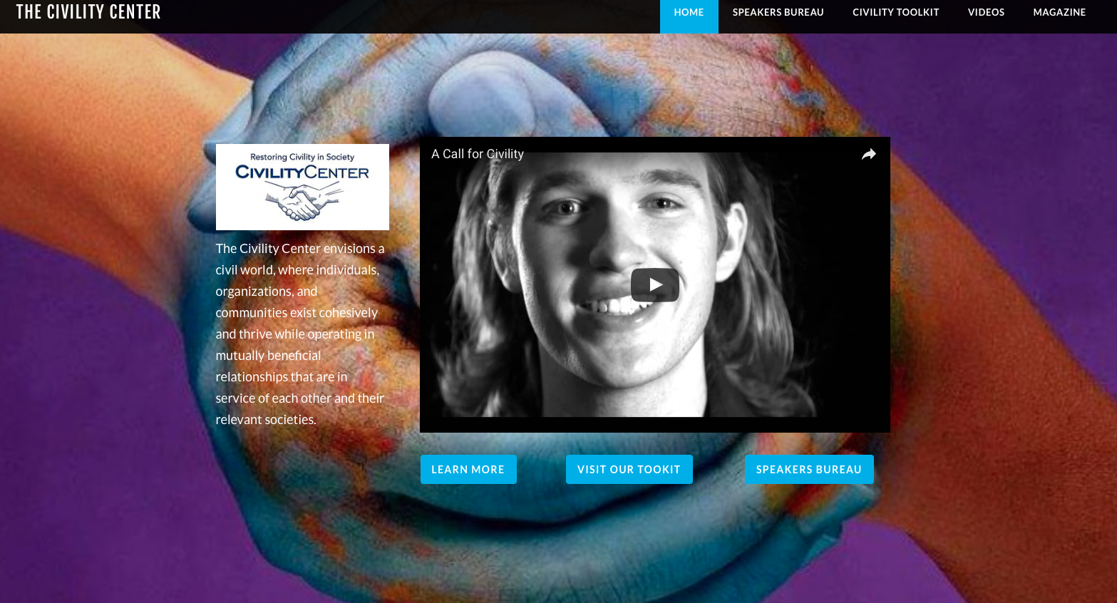
Notes:
‹#›
‹#›
So what can you do

Slide 9
What are the next steps?
Create awareness of civility, share the concept
Exemplify by our own behavior
Promote civility in our lodge communications
Create Civility Training in our Lodge Programs
Join the effort to explore strategies for the future
s
Notes:
‹#›
‹#›
Here is something you can do

Slide 10
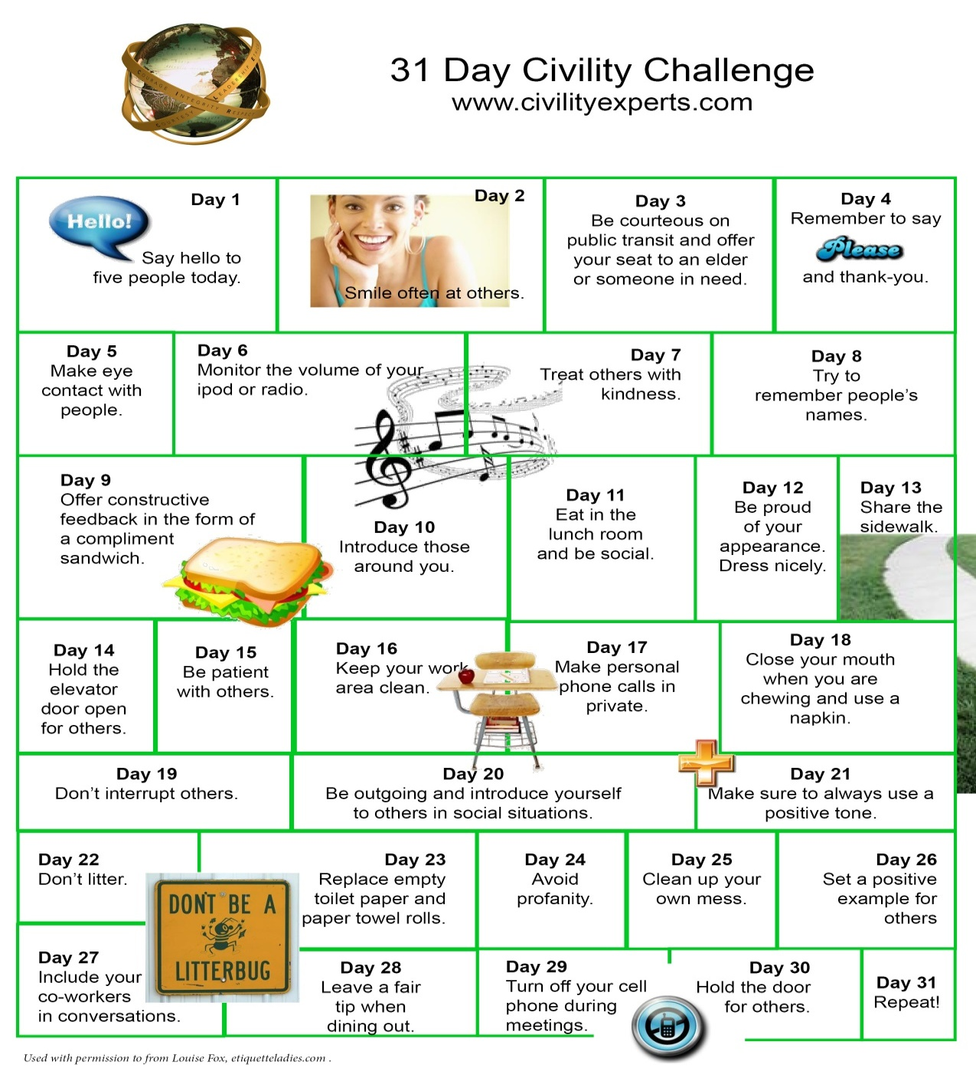
Notes:
‹#›
‹#›

Slide 11
THANK YOU!
Please reach out for more information!
CivilityCenter.org
Info@CivilityCenter.org
Civility Center
www.CivilityCenter.org
Notes:
‹#›
‹#›

