Slide 1
MASONIC FAMILY CIVILITY PROJECT
South Dakota Annual Communication of Grand Lodge
By Russ Charvonia Past Grand Master of Masons in California 2014/15

Slide 3
“The journey begins with each of us.”
MASONIC FAMILY CIVILITY PROJECT
In 2014, Masonic leaders across North America joined forces to address the need for a more civil society. Much progress has been made!

Slide 4
WHY US?
MASONIC HERITAGE
CULTURAL SENSITIVITY
DELIVERY SYSTEM
Masons have a long history
of fostering civil dialogue and building civil societies.
Masons are diverse and our
lodges represent people of different:
Places of origin
Language
Races
Disability
Other
Our lodges and worldwide presence provide an intriguing system to deliver
programs and information.

Slide 5
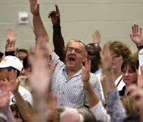
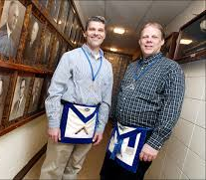
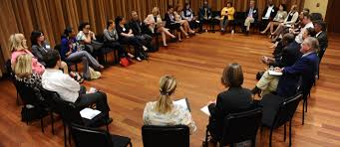
THE NEED
SOCIETY
LODGES
ENGAGEMENT

Slide 6
OUR ACCOMPLISHMENTS
WHAT WE HAVE DONE
Wikipedia Definition
Masonic Task Force
Civility Ambassadors
Scorecard
Speakers Bureau
MasonicCivility.org
#Masons4Civility
Convening

Slide 7
NEXT STEPS
Observe our own behavior
Smooth our rough ashlars
Become a Civility Ambassador
Look for opportunities to share with community
Presume decency in others

Slide 9
THANK YOU!
Please contact me for more information!
Russ@MasonicCivility.org
Russ Charvonia
MasonicCivility.org

