Slide 1
Why Civility Matters in the Lodge
MASONIC FAMILY CIVILITY PROJECT

Slide 2
What is Civility?
Civility is essential for the success of any society. It is grounded in respect and in an attitude of inclusiveness.
When we practice civility we remind ourselves about the impact of our actions on others while contributing to the well being of our family, community and society at large.
Civility advocates for treating others as you would want them to treat you.
We can all define what it is NOT --- How do we define what civility is?
“It’s a journey.”
“It’s the embodiment of the Ten Commandments.”
“It’s the Golden Rule, applied.”

Slide 3
Would You Believe?
Wikipedia has long had a definition of “incivility” but only in the last year or so has a definition of “civility” been tendered and approved.

Slide 4
Why Civility Now?

Slide 5
Let’s Look at the Numbers
81% of Americans think that incivility is leading to an increase in violence.

Slide 6
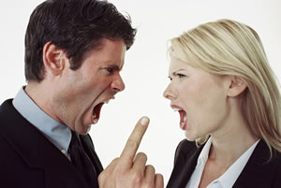
70% of Americans believe incivility has reached crisis proportions. With Americans encountering incivility an average of 2.4 times a day.
Source- Civility in America: A Nationwide Survey, conducted by global public relations firm Weber Shandwick and public affairs firm Powell Tate in partnership with KRC Research

Slide 7
Civility Survey
Do you believe society is in need of greater civility?

Slide 8
Civility Survey
Taking yourself, your family and your community as an example:
How often do you witness acts of incivility?
.

Slide 9
Thinking about our society and communities as a whole…
How concerned are you about the level of incivility you witness?

Slide 10
Personally, I feel Incivility is a problem in:

Slide 11
Our Future Members and Leaders
92% of teens say they feel social media, e.g., Facebook and Twitter is making us a less civil society.

Slide 12
As Masons, can we help restore civility in society?

Slide 13
Why Civility Now?
Based on these observations, if incivility was a disease, it would be an epidemic.

Slide 14
With so much acknowledged incivility in the world, why would you allow it to take hold in your lodge?

Slide 15
Why Civility in the Lodge?

Slide 16
Why Civility in the Lodge?
Remember the Compass
Improves member retention
Improves member attendance
Improves new member attraction
Improves our public image
WE can be the force for change

Slide 17
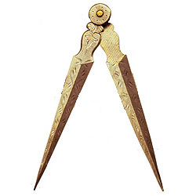
The Compass

Slide 18
Why Does All Of This Matter? Member Retention
A recent poll showed that 26 % of people have quit a job because it was an uncivil workplace.
If people are willing to leave a job, how many more would be willing to leave a lodge?

Slide 19
Impact on Member Attendance and Attraction
Public rudeness among employees is common. Whether it’s waiters berating fellow waiters or store clerks criticizing colleagues, disrespectful behavior makes people uncomfortable, and they’re quick to walk out without making a purchase.
How many brothers are walking out for the last time and how many potential members are never coming back due to incivility?

Slide 20
Increased Distraction from Greater Things
According to a study conducted by Accountemps and reported in Fortune Magazine, managers and executives at Fortune 1,000 firms spend 13% percent of their work time—mending employee relationships and otherwise dealing with the aftermath of incivility.
How would you rather spend your time, refereeing incivility in the lodge or taking action in your community, welcoming new brothers, and making a difference?

Slide 21
Cost and Consequences of Incivility to Lodges
Reduced enthusiasm
Declining attendance
Dwindling active membership for projects, activities, and service
Reduced public awareness or opinion
Poor member experience

Slide 22
Stress at work also impacts our relationships
Respondents indicated that on average job stress accounted for 73% of their overall life stress.
59% of respondents said that the quality of their home and family life was sometimes impacted by job stress
16% said that job stress frequently impacted their personal and family life.
Source: Human Solutions Report, Under Pressure

Slide 23
Do you want your Lodge to be a stress point in anyone’s life?
With all of the other potential stresses in a person’s life, why not make the lodge a refuge; a place of friendship, support, and understanding. This does not mean we need to always agree. It means we need to be able to express our differences in a way that is constructive without being a source of incivility, stress, and contention.

Slide 24
Incivility Contributes to:
Reduced officer and lodge efficiency
Reduced member morale
Less innovation
Absenteeism
Loss of resources and talent
Lower Productivity as a group (Many hands)

Slide 25
…Lower Quality Experience for Everyone

Slide 26
Think About This…
If incivility was present in your lodge, would you invite a friend to come to anything your lodge planned? How about a member of your family?
If you experienced incivility, even if it was just a couple of times, would you keep coming back, especially if nobody seemed to care that it was happening?

Slide 27
How do we fix it?

Slide 28
FIRST…REMEMBER WHO WE ARE
CULTURAL SENSITIVITY
MASONIC HERITAGE
We have a long history
of fostering civil dialogue and building civil societies.
We are a group of like-minded men but our lodges
represent a diverse group of people of different:
Places of origin
Language
Races
Ability
Knowledge
And much more

Slide 29
How Do We Fix It?
Be Self-Aware
25% of managers who admitted to having behaved badly said they were uncivil because their leaders—their own role models— were rude. And, in a survey of 1000 American Executives Michelle McQuaid, a leader in Positive Psychology interventions, found that only 35% of Americans are happy at their jobs. 65% say a better boss would make them happy. And only 35% say a pay raise will do the same thing.

Slide 30
How Do We Fix It?
Be Self-Aware
Be mindful of how you treat and talk to officers, members, and their families, especially if you are in a leadership role. Remember, none of us HAS to be here. Seek solutions through civil dialogue and understanding. Lead with… Brotherly Love

Slide 31
How Do We Fix It?
Engender Trust
In Edelman’s Trust Barometer, where results from 31,000 respondents representing 26 markets around the world were gathered, only 18% of those surveyed trust business leaders to tell the truth. That is just slightly higher than the statistic for trusting government officials, which was only 13%.

Slide 32
Engender Trust Amongst Leaders and Brothers
As a leader, be a resource of truth, trust and reliability. Be a positive example to follow, so that those who follow can replicate that good example. Be an inspiration and model of civility.
Have projects and programs (Work and Play) away from ceremonial lodge activities that encourage the members to spend more time together. (Bonding through common suffering)

Slide 33
Listen Actively
Members will frequently tell you when they are unhappy and why. See this as an opportunity to listen actively, without being defensive, and seek solutions that satisfy both sides.
When this is not possible, both sides will need to be active listeners, be willing to see the other person’s side, and be willing to accept the circumstance without creating turmoil in the lodge by continuously voicing their disagreement.
Attentive Ear

Slide 34
Personally
Be Self-Aware
Make a commitment to be more civil. Consciously pay attention to your own actions and communication with others. (Take a deep breath)
Think the best of others
Incivility often arises when we feel we have been intentionally wronged, disregarded, or disrespected. However, such transgressions are usually committed without malice and more from a lack of awareness.
Be Self-Actuating
Seek out and recognize opportunities to introduce or engage in civil discourse during times of disagreement or outright conflict.
Encourage Others
In times of calm, gently engage in a conversation about civility awareness (Instructive Tongue)

Slide 35
Consider the Resources Available to You
Variety of online resources for individuals, families, lodges, workplaces, and nations
Develops useful material with input from more than 4 dozen participants and 20 Grand Lodges
We have recruited and trained Ambassadors from countries world-wide
We have developed a Civility Scorecard
Social Media Presence
-MasonicCivility.org and Facebook Group
Take The Challenge
CIVILITY TOOLBOX
MASONIC CIVILITY TASK FORCE
AMBASSADORS AVAILABLE
CIVILITY SCORECARD
SOCIAL MEDIA
31 DAY CIVILITY CHALLENGE

Slide 36
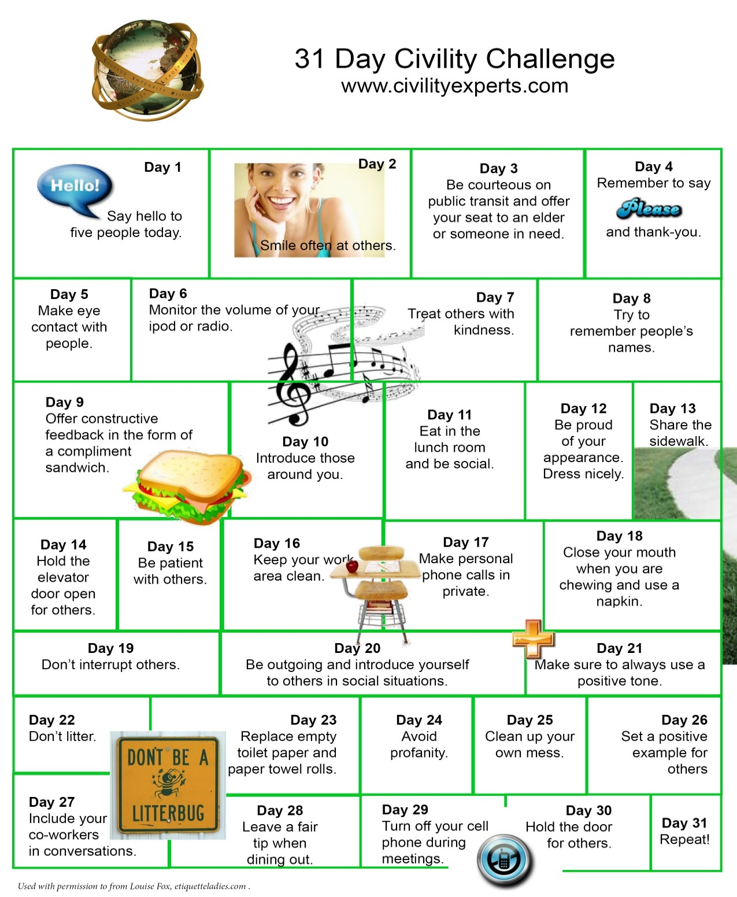
Take the 31 Day Civility Challenge

Slide 37
Most people do not make a conscious decision to be uncivil. In fact, being uncivil takes no conscious effort at all. It just happens. Civility, especially in the heat of a moment, takes effort and consideration. But like anything else we do consciously and regularly, Civility, if practiced regularly, will soon become a part of who we are. It will become an unconscious manner of behaving, and will benefit our lodges, our members, and our communities for generations to come.
You can be a force for change.

Slide 38
“That journey begins in our Lodges and with each of us.”
MASONIC CIVILITY EFFORT
In 2014, Masonic leaders across North America embarked on a journey to address the need for a more civil society.

Slide 39
Visit and use the following resources frequently
1) Civility Task Force Ambassadors available to you and your lodge
(Information, Presentations, Conflict Resolution Assistance)
2) Civility Toolbox- AVAILABLE TO ALL MASONS IN NORTH AMERICA
http://www.civilityresources.com/Civility-Resources.html
3) Civility Scorecard
Scorecard-contact info@MasonicCivility.org or Russ Charvonia at 805-258-1037
4) Take the 31-Day Civility Challenge
5) Visit Our Social Media Outlets Frequently for Updated Material and Insight
Masonic Civility website- Masoniccivility.org
Facebook Group
6) Support these efforts through The Civility Shop at www.CivilityShop.org

