Slide 1

Civility in Society
Anacapa Middle School

Slide 2
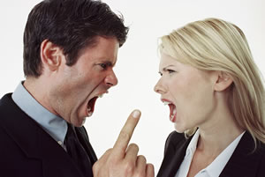
Thinking about the Past Week
Did you encounter any acts of incivility?

Slide 3
How did that make you feel?
What did you do about it?

Slide 4
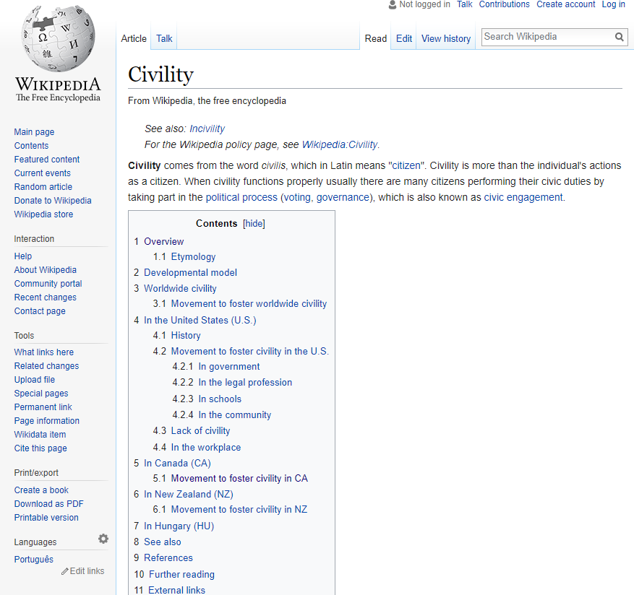
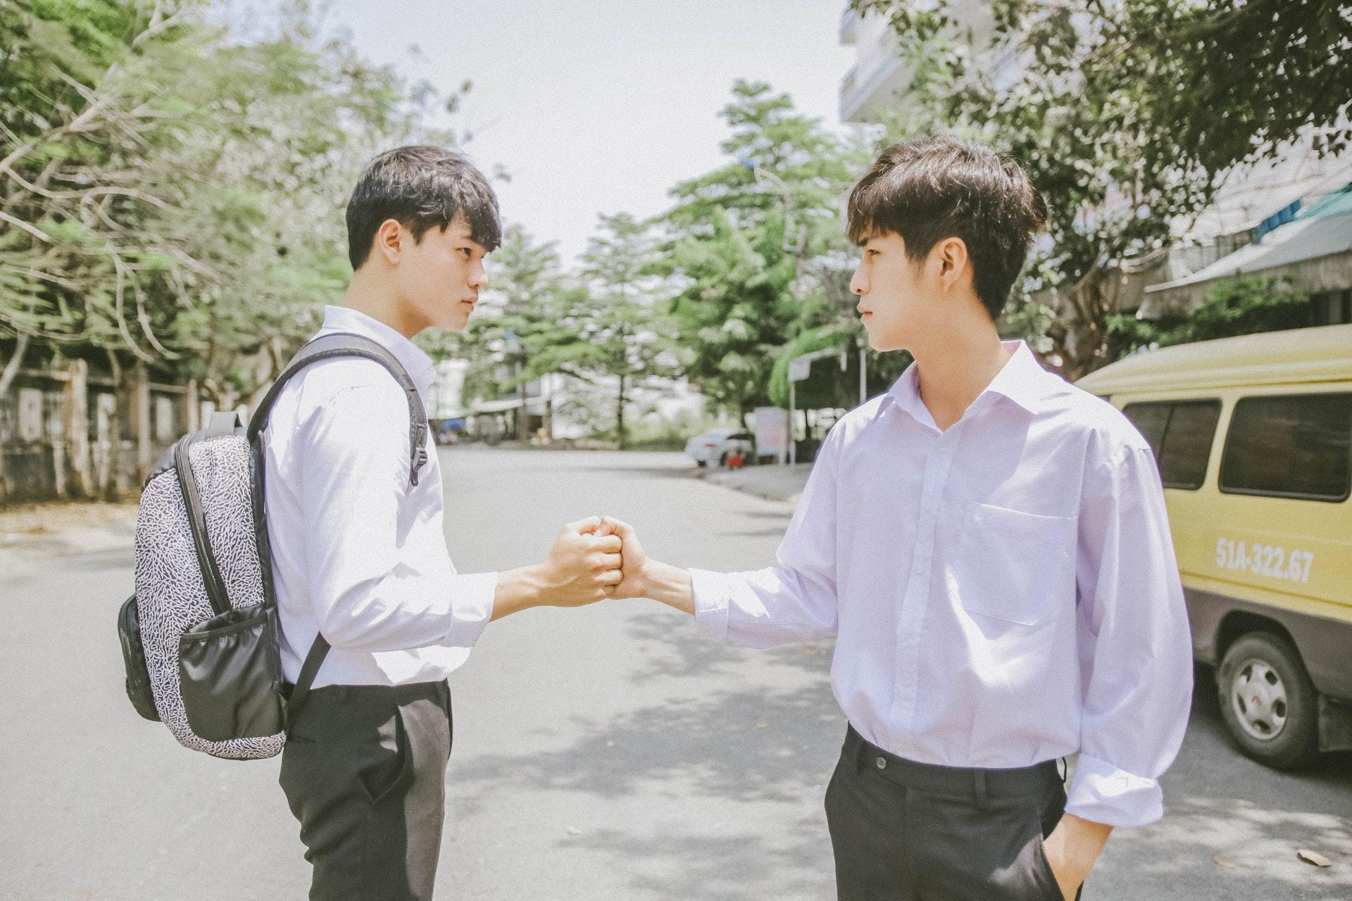
Would You Believe?
Wikipedia has long defined “Civility” by: “SEE INCIVILITY”
Only recently has a definition of “Civility” been accepted by Wikipedia.

Slide 5
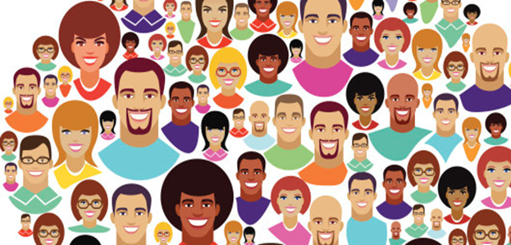
“The journey begins with each of us.”
DIVERSITY
Understand
Accept
Appreciate

Slide 6
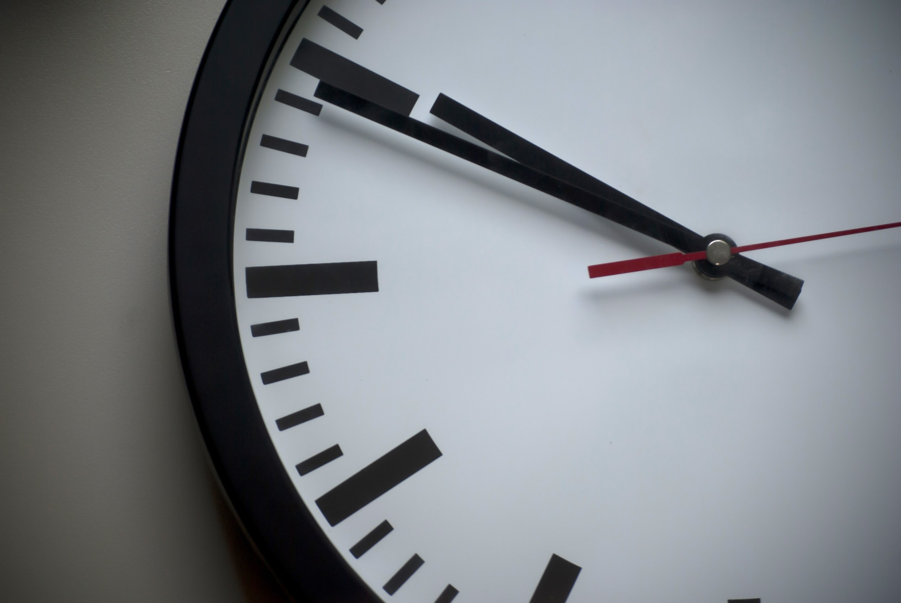

Why Civility Now?

Slide 7
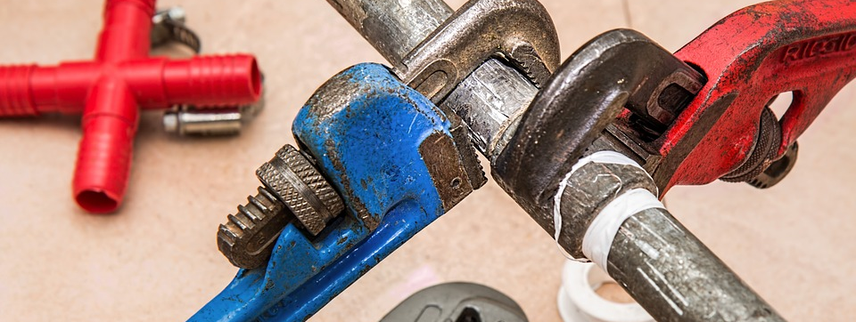
How do we fix it? it?

Slide 8

CIVILITY TOOLBOX
CIVILITY TOOLS
Resources for individuals, families, schools, workplaces, communities and government.
Available through CIVILITYCENTER.ORG

Slide 9
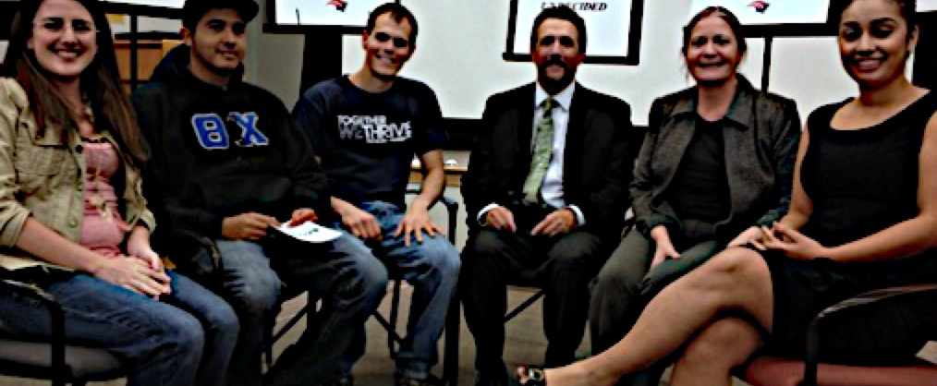
CIVIL DIALOGUE

Slide 11


CIVIL DIALOGUE
Forbidding cell phones at all times during the school day is good
for the learning process.

Slide 12
CIVIL DIALOGUE
Students who cannot provide their own uniforms and equipment should not be allowed to
participate in intramural sports.

Slide 13
CIVIL DIALOGUE
Mandatory school uniforms are vital to student academic and citizenship achievement.

Slide 14
GROUND RULES OF CIVILITY
Be passionate without being hostile.
Focus on how the statement makes you feel
Participants should use truthful speech that does not attack others.
Use “I” language
Disagree without demonizing
Use Active Listening.
Listen patiently; do not interrupt.
Do not engage in fake listening as you plan out what you want to say next.

Slide 15
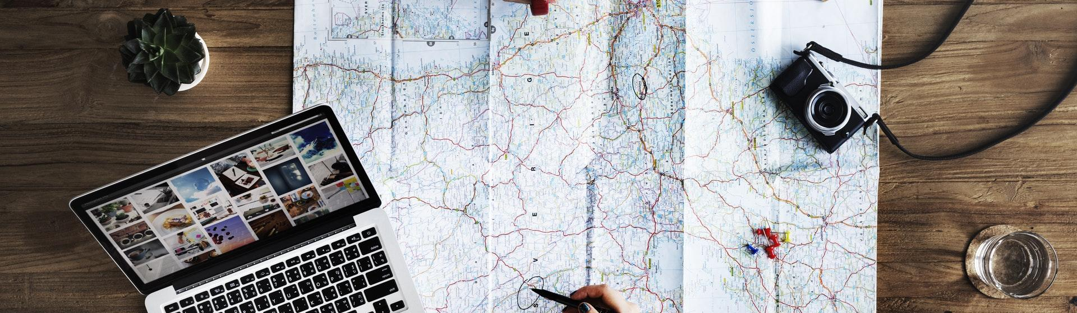

NEXT STEPS
Observe our own behavior
Utilize the Toolkit
Become a Civility Ambassador
Look for opportunities to share with community
Presume decency in others

Slide 16

Just as Incivility Happens, so does Civility. The difference is that being uncivil takes no conscious effort at all. It just happens.
Civility takes effort and consideration.
But like anything else we do regularly, it will soon become a part of who we are, and will become effortless.

Slide 17


Slide 18
THANK YOU!
Please contact me for more information
Russ Charvonia
Russ@MasonicCivility.org
805.258.1037
MasonicCivility.org

