Slide 1


MASONIC FAMILY CIVILITY PROJECT
Progress and Next Steps
By Russ Charvonia
Past Grand Master of Masons in California 2014/15

Slide 2
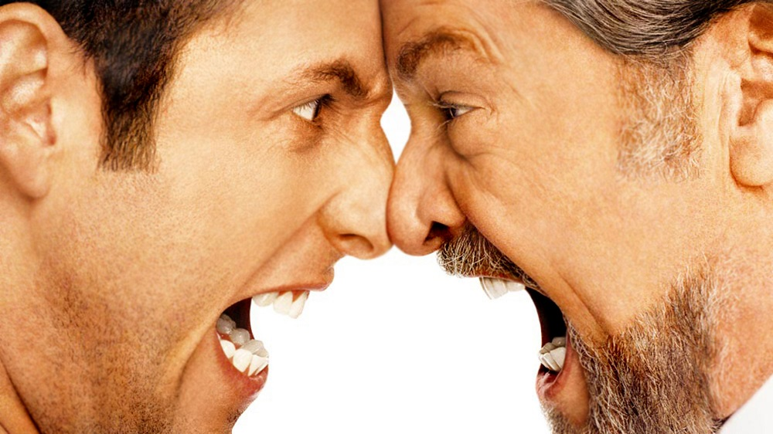

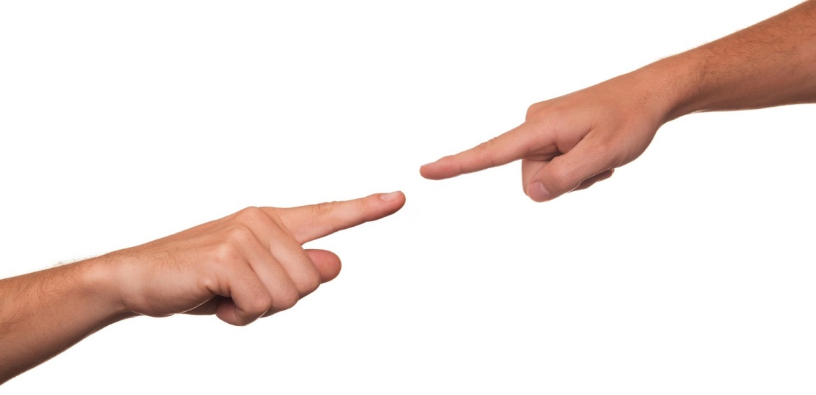


Slide 4
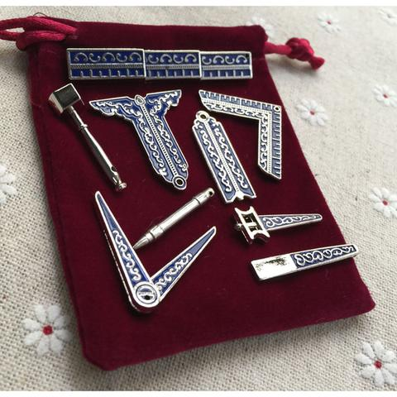
We Have the Tools

Slide 5

Masonic Mentorship

Slide 6
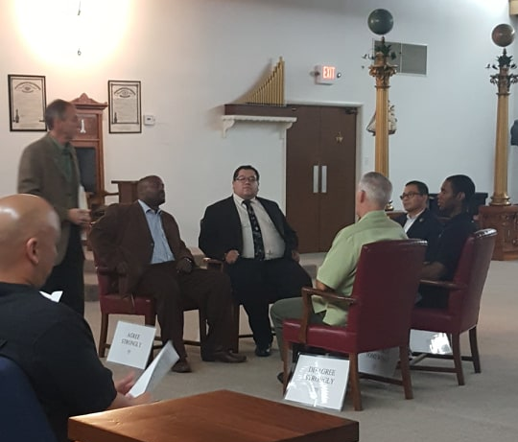
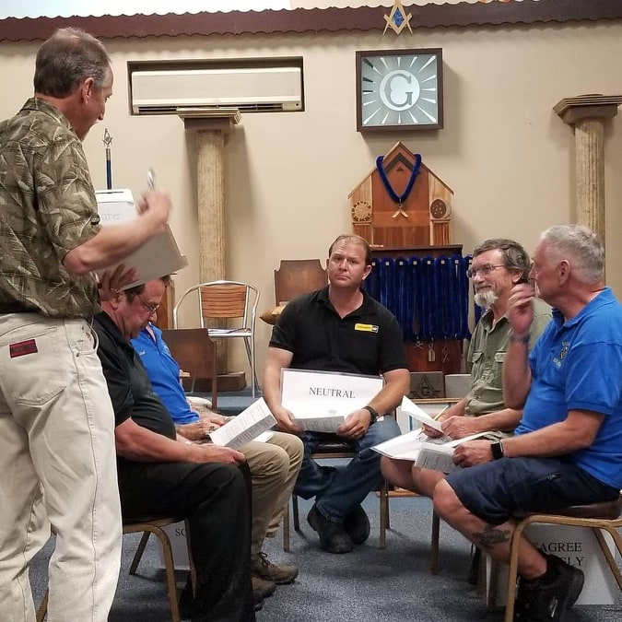
Just Two Presentations of Hundreds

Slide 7
Become or Appoint a Civility Ambassador

Slide 8

The Civility Scorecard was conceived with the idea that providing a software tool to objectively rate the civility attributes of speeches and articles will help promote more civil dialogue.
The science behind Civility Scorecard
The uniqueness of Civility Scorecard
https://CivilityScorecard.com

Slide 9
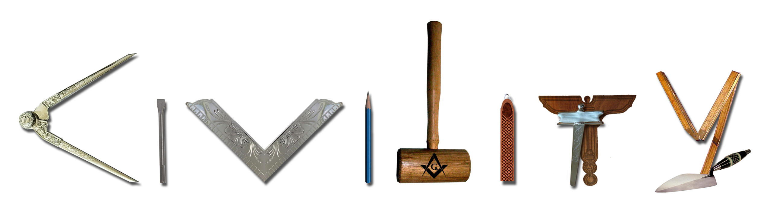
The Masonic Family Civility Project
Promoting Masonic values to restore civility in society.
MasonicCivility.org info@MasonicCivility.org
Notes:
spruce

Slide 10
CivilityShop.org

Slide 11
WHY US?
MASONIC HERITAGE
CULTURAL SENSITIVITY
DELIVERY SYSTEM
Masons have a long history
of fostering civil dialogue and building civil societies.
Our lodges and worldwide presence provide an intriguing system to deliver
programs and information.
Masons are diverse and our
lodges represent people of
different:
Places of origin
Language
Races
Disability
Other
Notes:
Engaging the bretheren

Slide 12

“The journey begins with each of us.”
MASONIC FAMILY CIVILITY PROJECT
In 2014, Masonic leaders across North America joined forces to address the need for a more civil society. Much progress has been made!

Slide 13

April 29 – May 1, 2019 at the George Washington Masonic National Memorial, Alexandria, VA
CivilityConvening.org

Slide 14
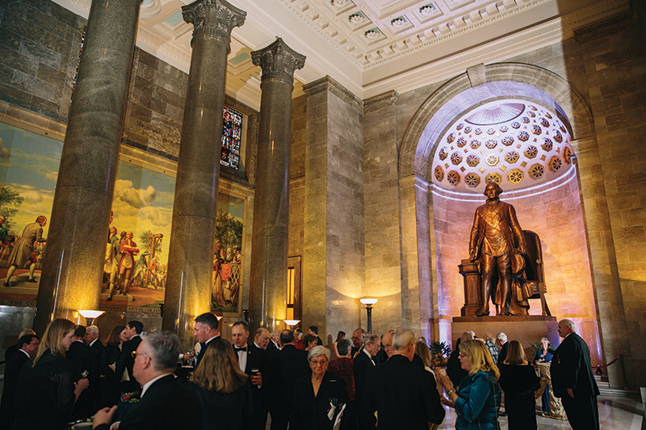

Slide 15
HOW CAN I GET INVOLVED?
Examine your own behavior and commit to striving for higher levels of civility in all your actions.
Go to MasonicCivility.org for resources to use in your Jurisdiction and among your lodges.
Promote civility in your lodge.
Become a Civility Ambassador. Email Info@MasonicCivility.org for more information.
Support the Masonic Family Civility Project and CivilityShop.org.
Attend Urgency of Civility conference.

Slide 17


Slide 18
THANK YOU!
Please contact me for more information!
RCharvonia@Freemason.org
805.258.1037
MasonicCivility.org

