Slide 1


LEADERSHIP and CIVILITY
Russ Charvonia
Founder of the Masonic Family Civility Project &
The Urgency of Civility Conference

Slide 2
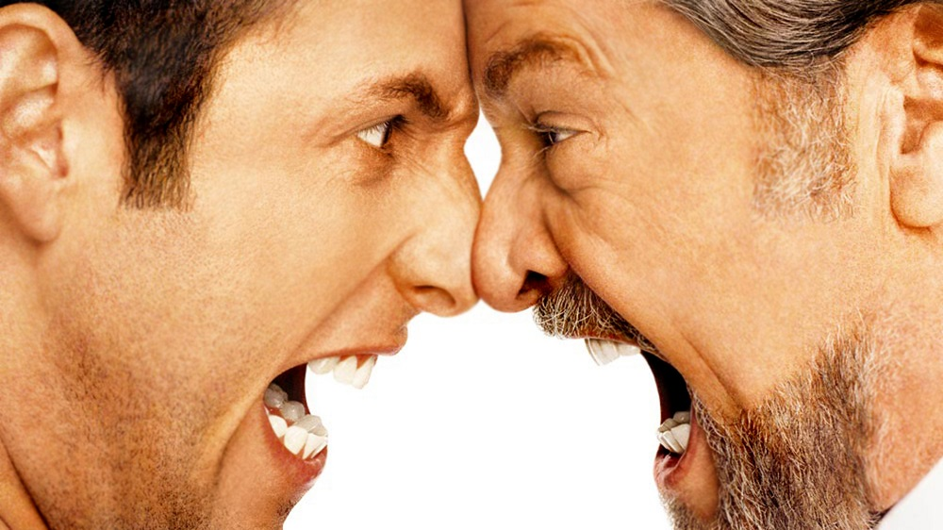



Slide 3
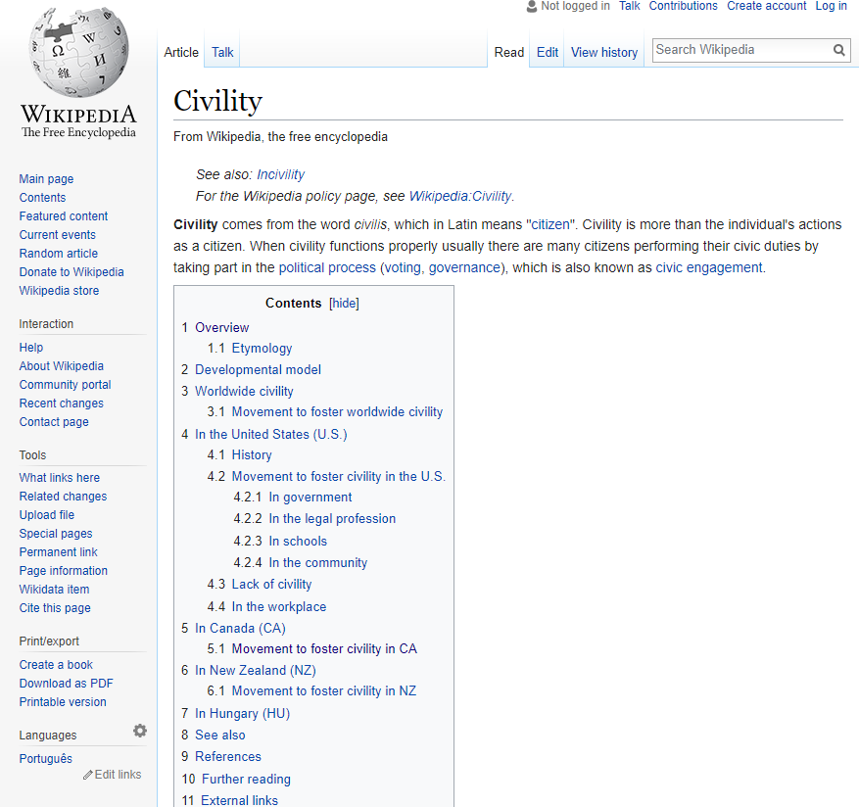
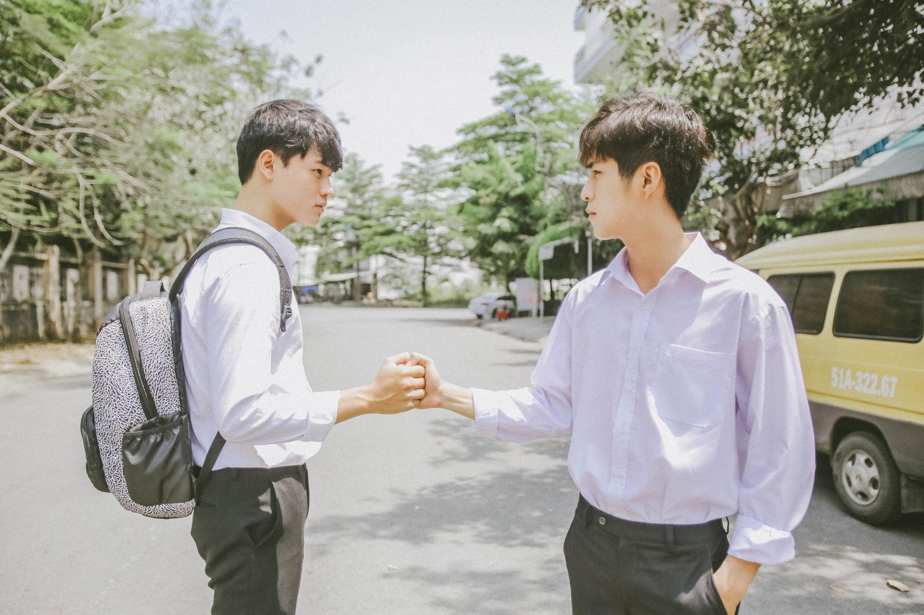
Would You Believe?
Wikipedia has long defined “Civility” by: “SEE INCIVILITY”
Only recently has a definition of “Civility” been accepted by Wikipedia.

Slide 4
3 ACTION ITEMS
What can/will you do as an individual?
What can/will you do as a leader?
How will you work to repair our world?

Slide 5

Mentorship vs. Leadership

Slide 6
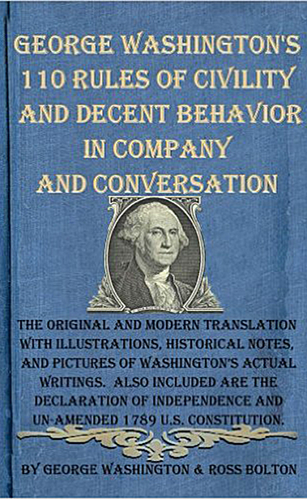

Slide 7
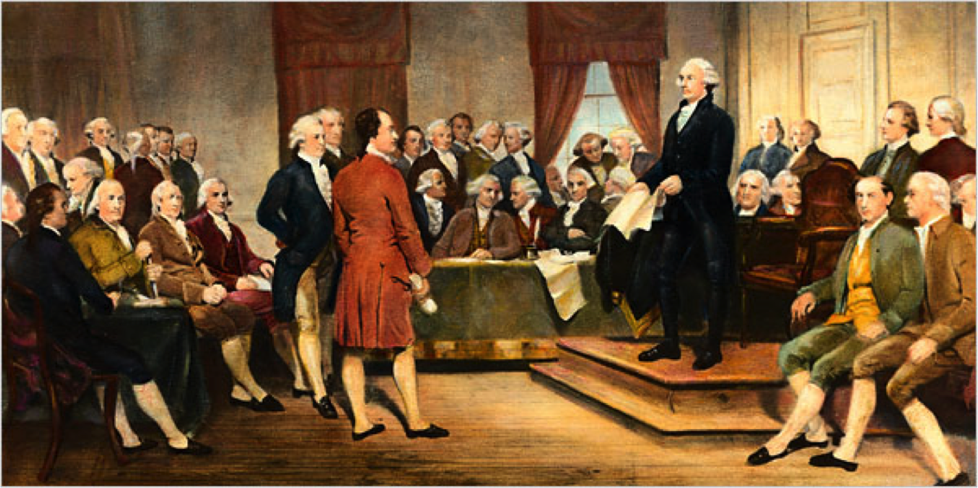

Slide 8

“The journey begins with each of us.”
DIVERSITY
Understand
Accept
Appreciate

Slide 9

CIVILITY TOOLBOX
CIVILITY TOOLS
Resources for individuals, families, lodges, workplaces, communities and government.
AVAILABLE TO EVERYBODY
CivilityCenter.org/Resources

Slide 10

The Civility Scorecard was conceived with the idea that providing a software tool to objectively rate the civility attributes of speeches and articles will help promote more civil dialogue.
The science behind Civility Scorecard
The uniqueness of Civility Scorecard
https://CivilityScorecard.com

Slide 11
THE 3 Ds
Debate
Deliberation
Dialogue

Slide 12
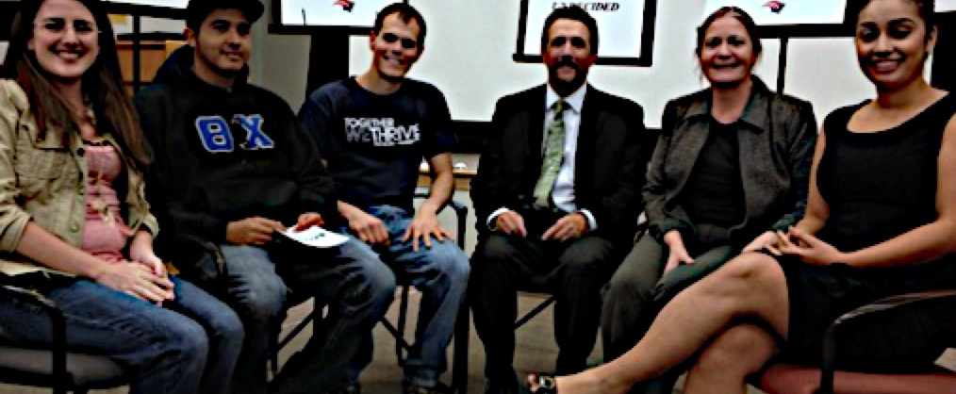
CIVIL DIALOGUE

Slide 14

CIVIL DIALOGUE
The Electoral College, in its current state, should be abolished.

Slide 15
GROUND RULES OF CIVILITY
Be passionate without being hostile.
Focus on how the statement makes you feel
Participants should use truthful speech that does not attack others.
Use “I” language
Disagree without demonizing
Use Active Listening.
Listen patiently; do not interrupt.
Do not engage in fake listening as you plan out what you want to say next.

Slide 16

April 29 – May 1, 2019 at the George Washington Masonic National Memorial, Alexandria, VA
CivilityConvening.org

Slide 17
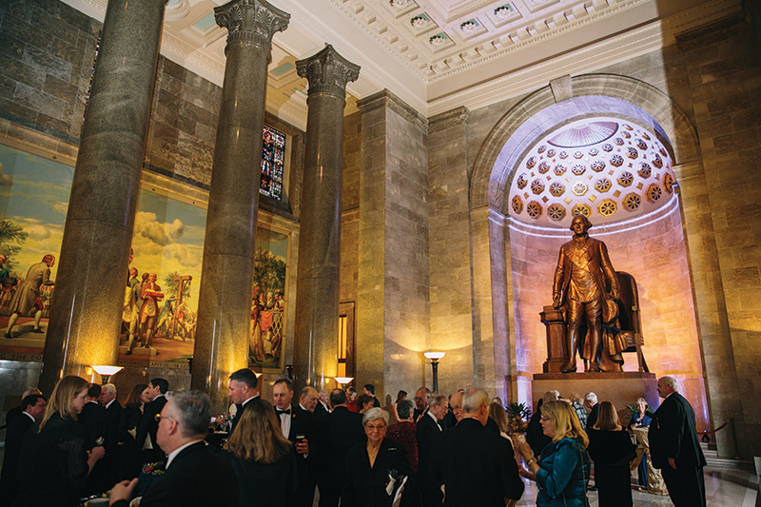

Slide 18
HOW CAN I GET INVOLVED?
Examine your own behavior and commit to striving for higher levels of civility in all your actions.
Promote civility in your community.
Become a Civility Ambassador.
  Email Info@MasonicCivility.org for more information.
4) Observe A Day Without Politics on October 20.

Slide 19


Slide 20
THANK YOU!
Please contact me for more information!
RCharvonia@Freemason.org
805.258.1037
MasonicCivility.org

