Slide 1


Masonic Civility in Uncertain Times
Grand Lodge of Canada in the
Province of Ontario
Presented by Russ Charvonia, PGM of California 2014/15

Slide 2
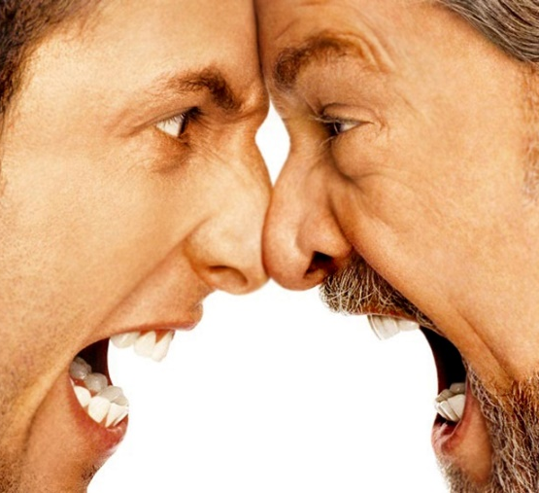
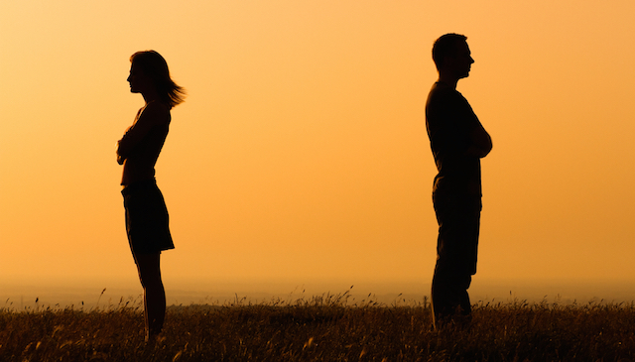
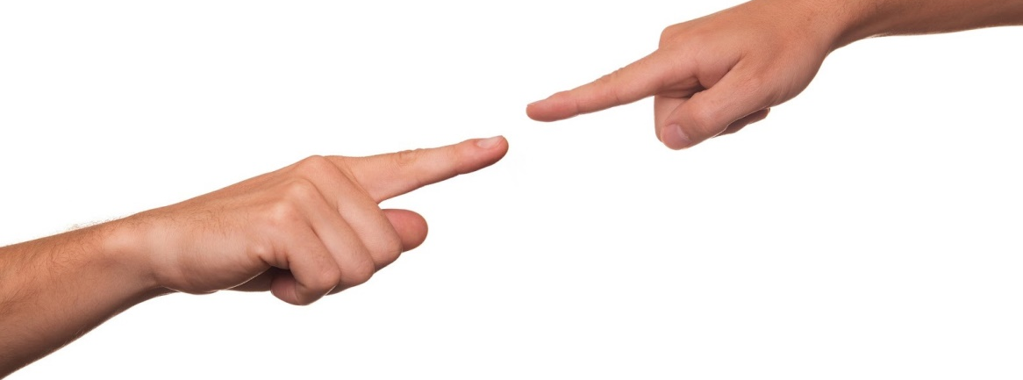

Slide 3

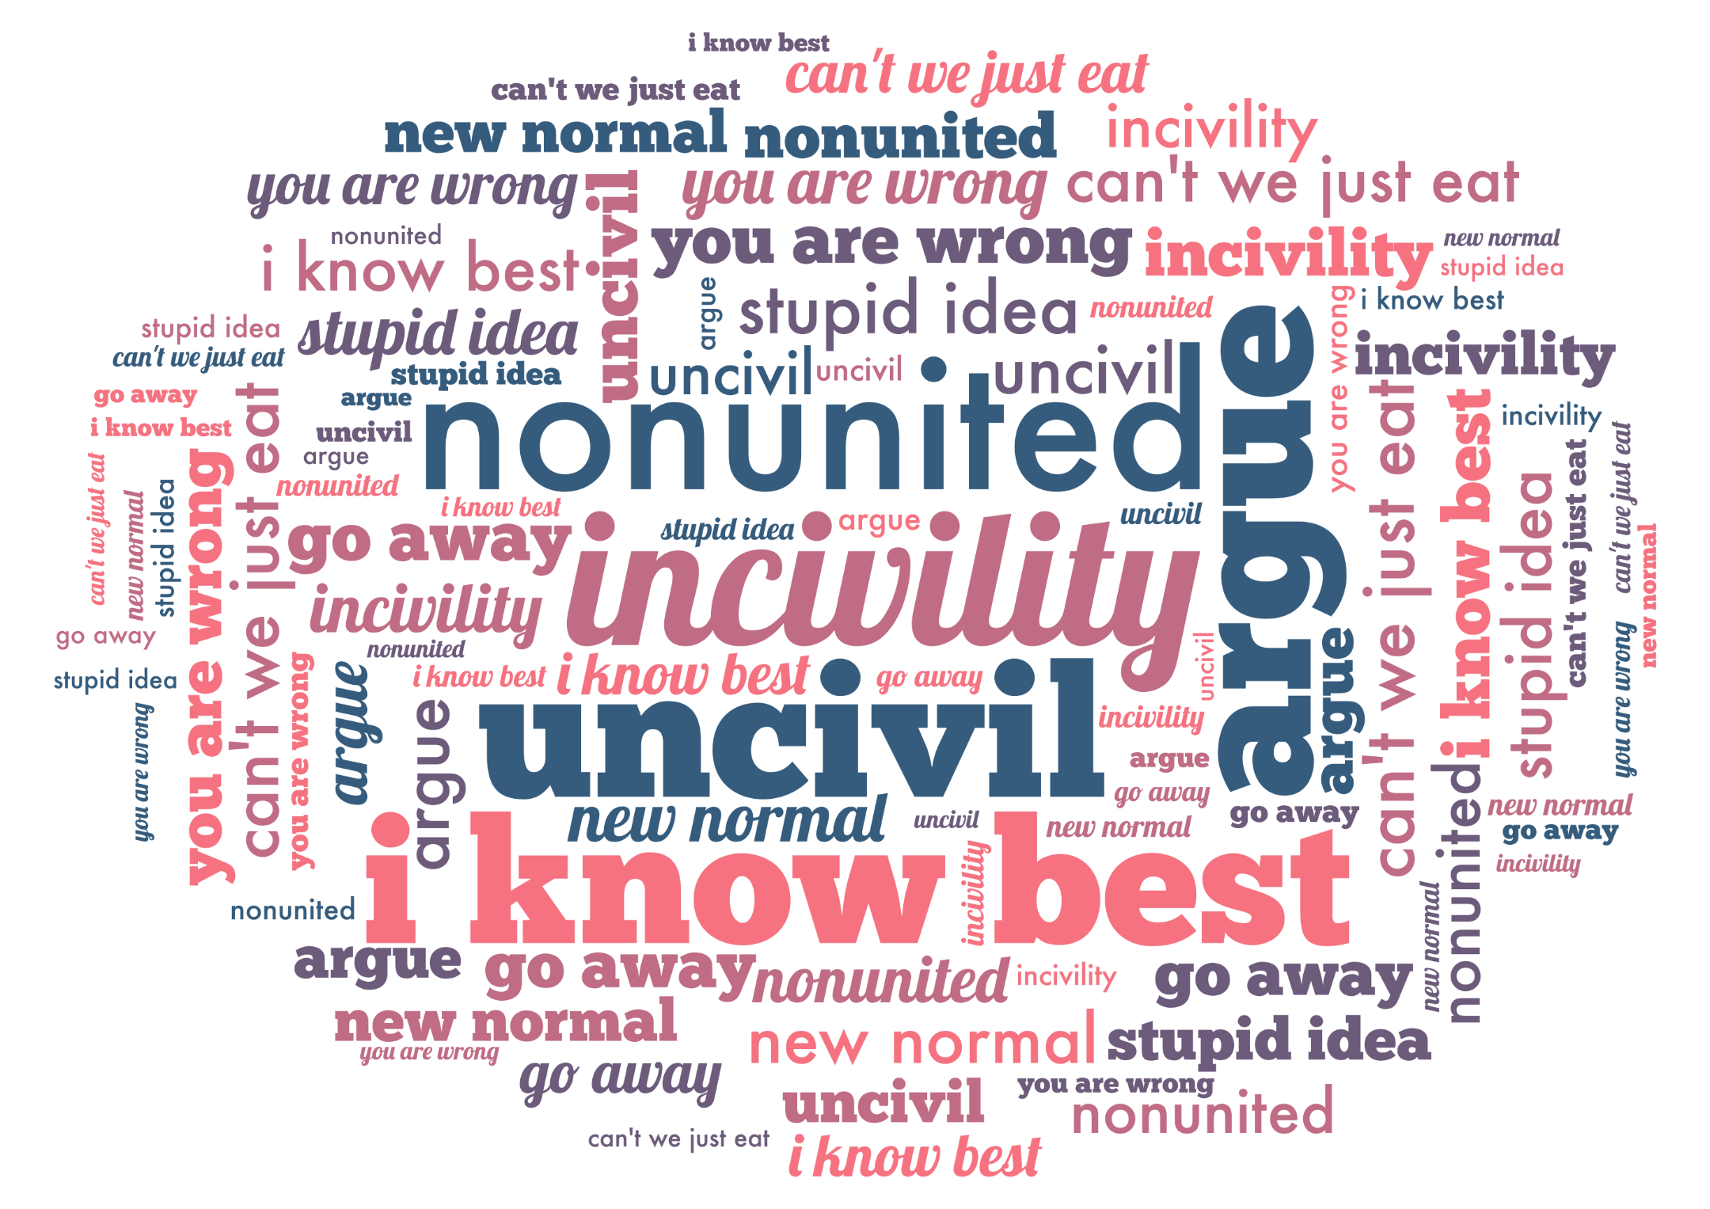

Slide 4

Towards Enlightenment…

Slide 5

True Enlightenment

Slide 6
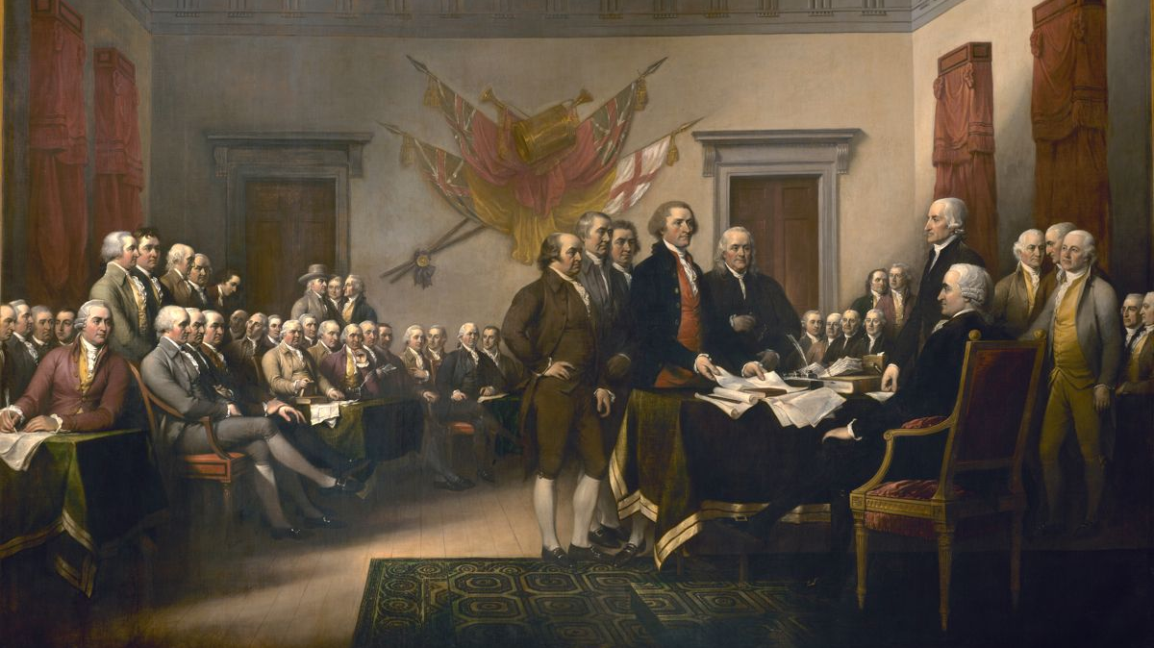
Using Masonic Ideals to Restore Civility to Society

Slide 7
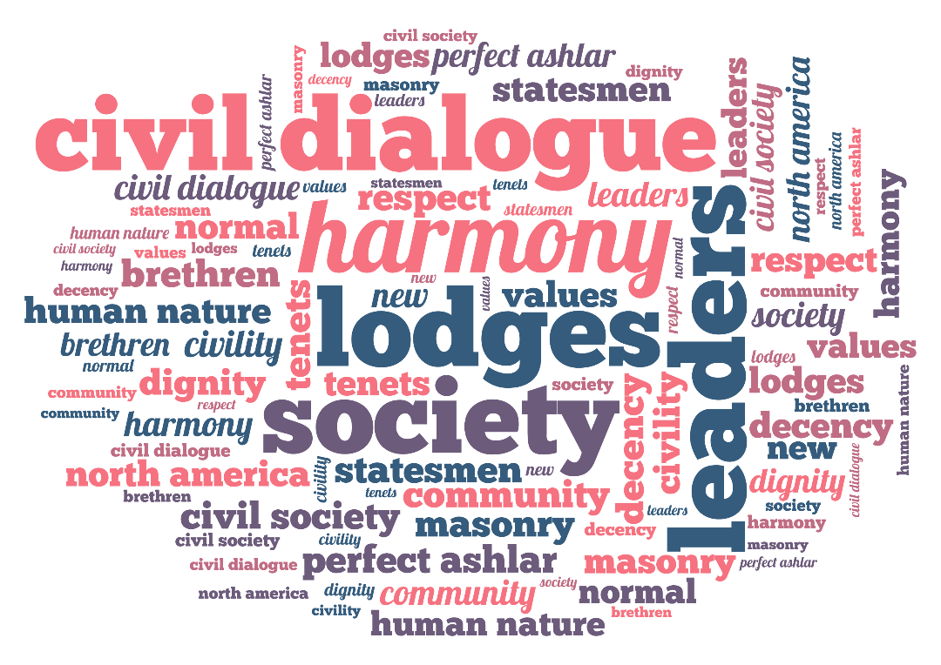
Is it time for the Masonic family to make a difference?

Slide 8
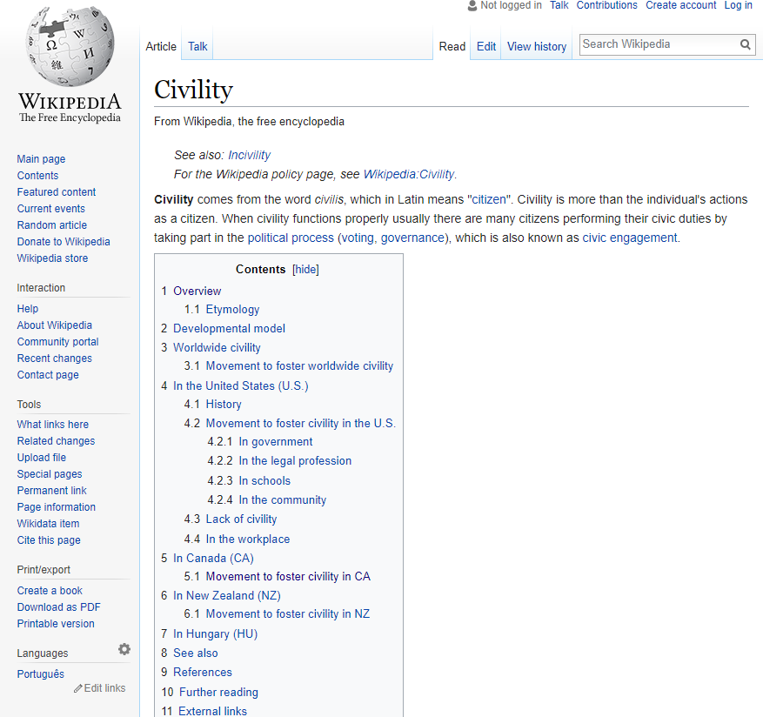
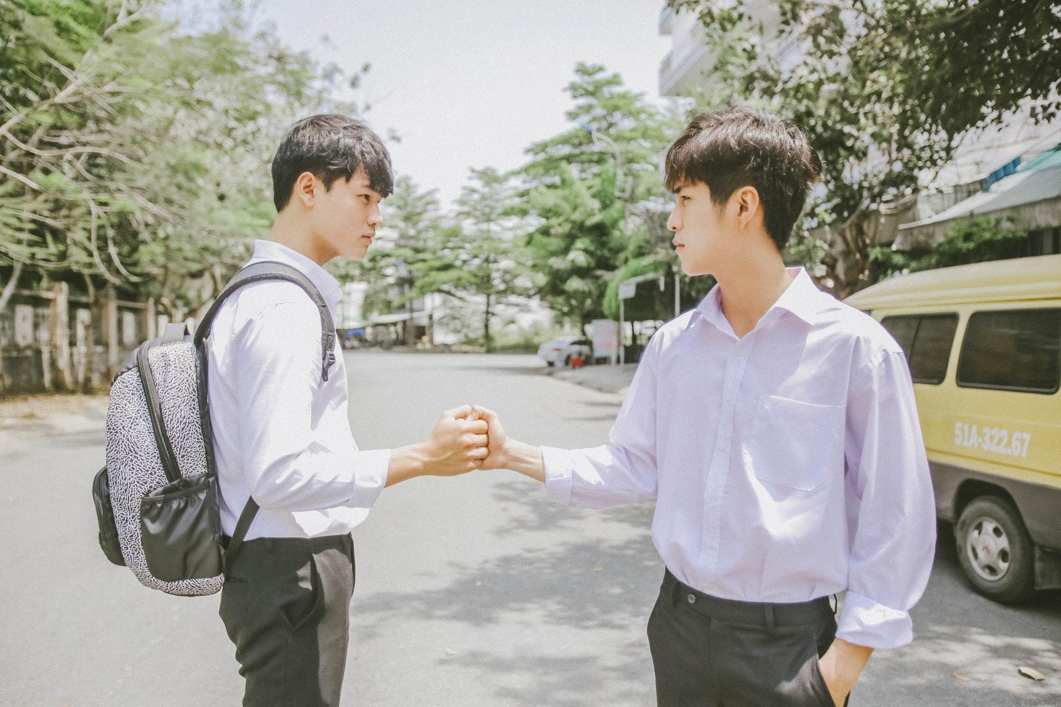
Would You Believe?
Wikipedia has long defined “Civility” by: “SEE INCIVILITY”
Only recently has a definition of “Civility” been accepted by Wikipedia.

Slide 9
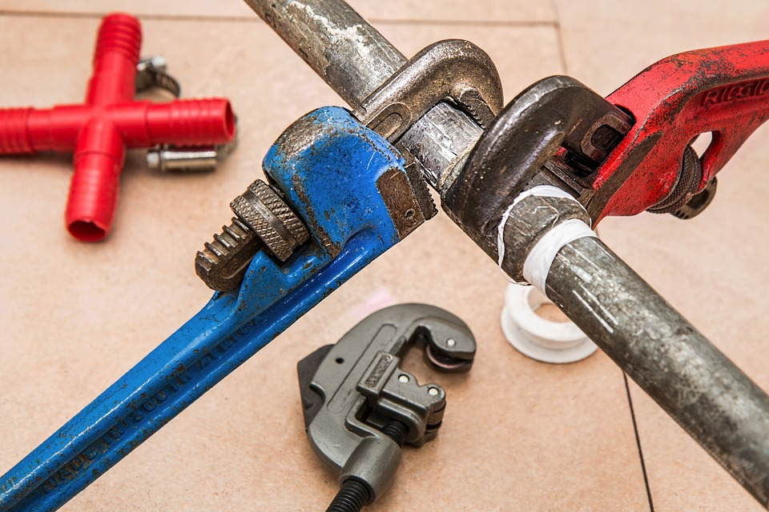
How do we fix it?

Slide 10
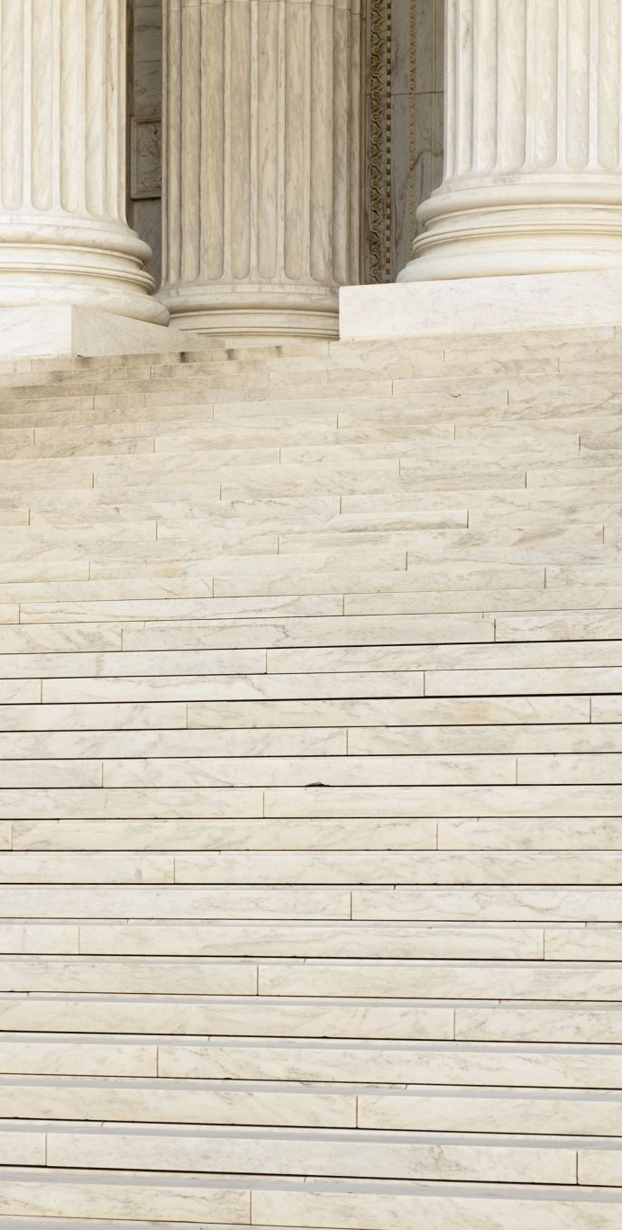
7 TENETS
Brotherly Love
Relief
Truth
Temperance
Fortitude
Prudence
Justice

Slide 11
7 DeMOLAY PRECEPTS
Filial Love
Reverence for Sacred Things
Courtesy
Comradeship
Fidelity
Cleanness
Patriotism

Slide 12

CIVILITY TOOLBOX
CIVILITY TOOLS
Resources for individuals, families, lodges, workplaces, communities and government.
AVAILABLE TO EVERYONE
CivilityCenter.org/Resources

Slide 13


Slide 14
Understand

Slide 15
Understand
Accept

Slide 16
Understand
Accept
Appreciate

Slide 17
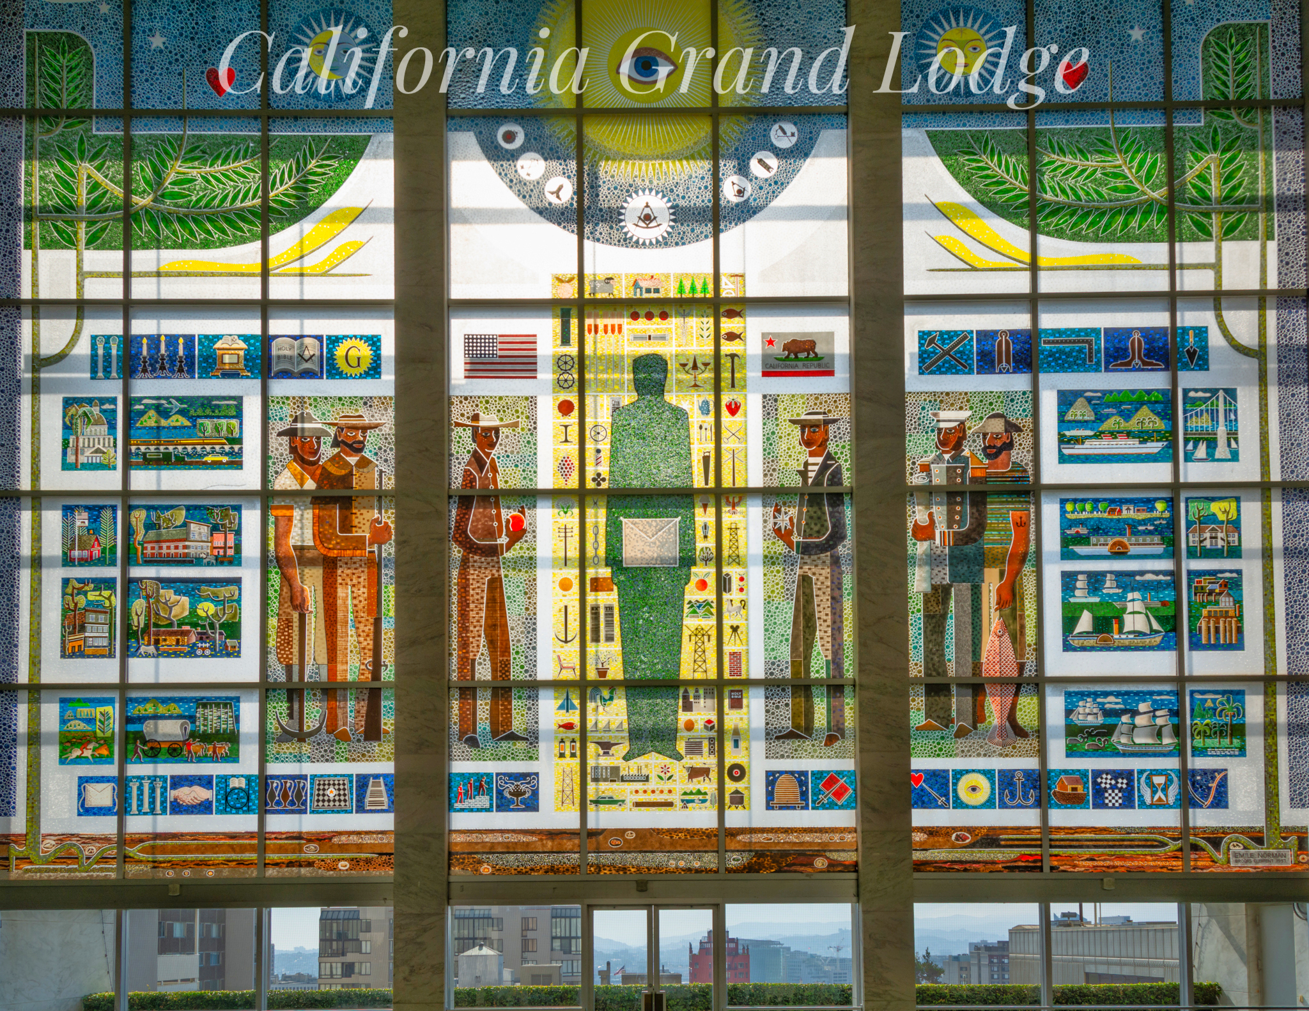

Slide 18
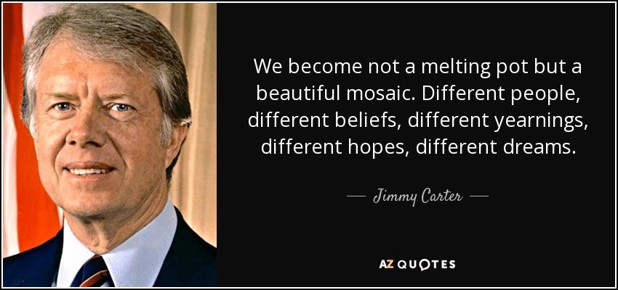

Slide 20


Slide 22
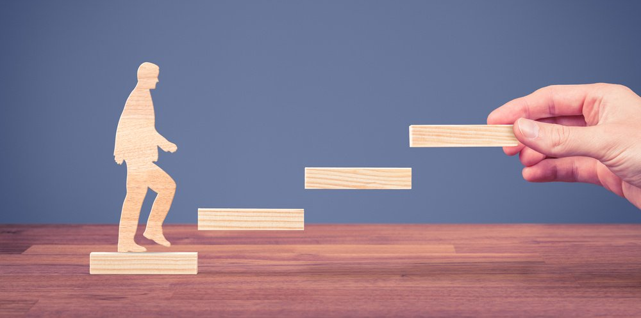
Masonic Mentorship

Slide 23
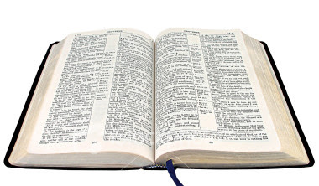

Slide 24
YBYA
Yes, but…
Yes, and…

Slide 25

SOCIAL MEDIA
#Masons4Civility
To quiet online conversations

Slide 26
Always remember that to argue, and win, is to break down the reality of the person you are arguing against. It is painful to lose your reality, so be kind, even if you are right.
…Haruki Murakami

Slide 27
THE 3 Ds
Debate
Deliberation
Dialogue

Slide 28
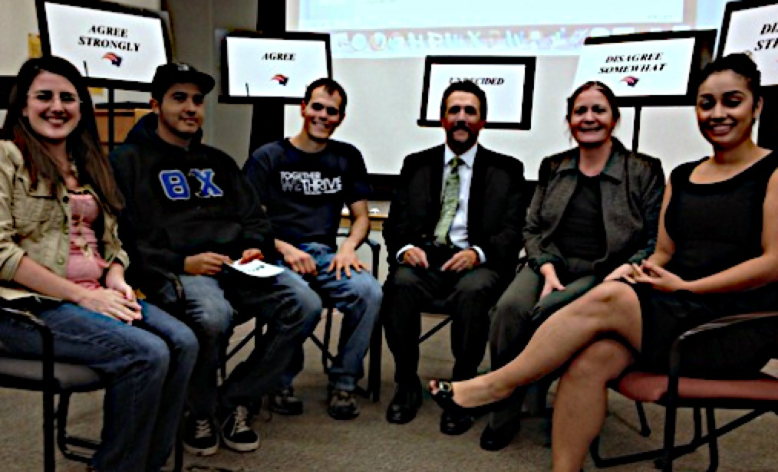
CIVIL DIALOGUE

Slide 29

NEUTRAL/
UNDECIDED
AGREE
SOMEWHAT
DISAGREE
SOMEWHAT
AGREE
STRONGLY
DISAGREE
STRONGLY

Slide 30
STATEMENT:
The Electoral College, in its current state, should be abandoned.

Slide 31
STATEMENT :
It is appropriate for Freemasonry
to sponsor a youth order
that is open to people of all genders.

Slide 32
GROUND RULES OF CIVILITY
Be passionate without being hostile.
Focus on how the statement makes you feel
Participants should use truthful speech that does not attack others.
Use “I” language
Disagree without demonizing
Use Active Listening.
Listen patiently; do not interrupt.
Do not engage in fake listening as you plan out what you want to say next.
Reframe
Information Source

Slide 33
Solomon’s Wheel
Truth
Justice
Brotherly Love
Prudence
Fortitude
Temperance
Blank
Relief

Slide 34
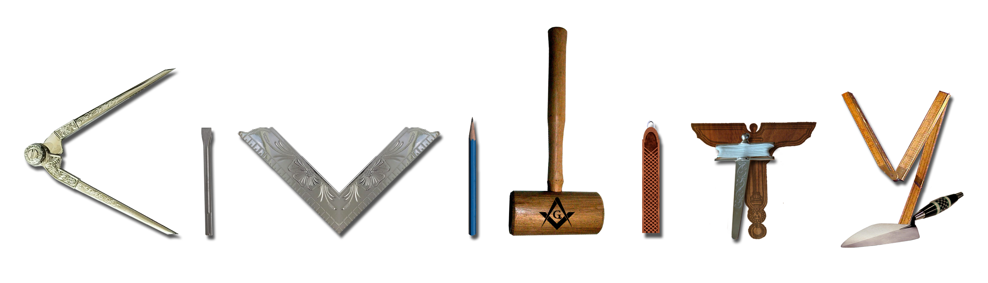

Slide 35






WORLDWIDE CIVILITY COUNCIL
ORGANIZATION CHART
WORLDWIDE
CIVILITY COUNCIL
Urgency of Civility Certified Civil Civility Scorecard Masonic Family Civility Shop
Civility Project

Slide 36

The Masonic Family Civility Project
Promoting Masonic values to restore civility in society.
MasonicCivility.org info@MasonicCivility.org
Notes:
spruce

Slide 37
The Civility Scorecard was conceived with the idea that providing a software tool to objectively rate the civility attributes of speeches and articles will help promote more civil dialogue.
The science behind Civility Scorecard
The uniqueness of Civility Scorecard
https://CivilityScorecard.com

Slide 38
CivilityShop.org

Slide 39
May 18-19, 2021
UrgencyOfCivility.org

Slide 40
Certified Civil™

Slide 41

NEXT STEPS
Examine your own behavior and commit to striving for higher levels of civility in all your actions.
Go to MasonicCivility.org for resources to use in your lodge and community.
Promote civility in your Lodge and community.
Become a Civility Ambassador.
Email Info@MasonicCivility.org for more information.
Support the Worldwide Civility Council and CivilityShop.org.
Attend Urgency of Civility conference.
Subscribe to Worldwide Civility podcast and YouTube.
Observe A Day Without Politics on October 20th.

Slide 42
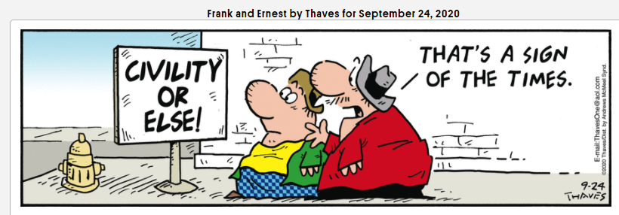

Slide 43

Just as Incivility Happens, so does Civility. The difference is that being uncivil takes no conscious effort at all. It just happens.
Civility takes effort and consideration
But like anything else we do regularly, it will soon become a part of who we are, and will become effortless.

Slide 44


Slide 45
THANK YOU!
Please contact me for more information
Russ Charvonia
Russ@MasonicCivility.org
805.258.1037
MasonicCivility.org

